Slide 1



HUMAN COMPUTER INTERACTION
(H.C.I)
Introduction

Slide 2
References
Alan Dix, Janet Finlay, Gregory D. Abowd, Russell Beale, " Human Computer Interaction," Third Edition, Pearson Education Limited 2004.
John Wiley & Sons, Inc “Interaction Design - Interaction Design - Beyond Human-Computer Interaction”.

Slide 3
Grading
Unknown Test and Assessments [5%]
Mid Term [15%]
Lab [20%]
Final Exam [60%]
Total [100%]

Slide 4
Historical Overview
Systematic study of human performance began in earnest at the beginning of the last century in factories.
The Second World War provided the impetus for studying the interaction between humans and machines.
Ergonomists have been concerned primarily with the physical characteristics of machines and systems, and how these affect user performance.

Slide 5

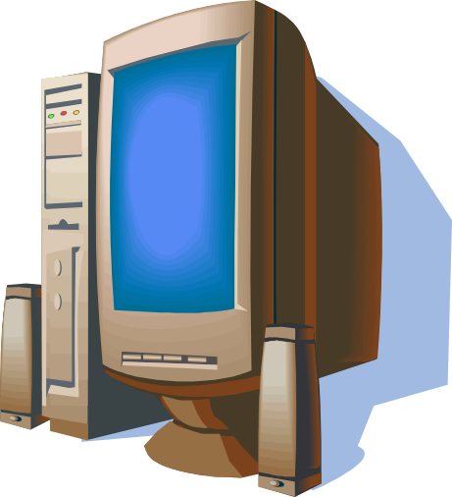
Interaction

Slide 6
What is HCI ?
Human-Computer Interaction, often called HCI.
HCI is a sociotechnological discipline whose goal is to bring the power of computers and communications systems to people in ways and forms that are both accessible and useful in our working, learning, communicating, and recreational lives.

Slide 7
What is HCI ?
HCI is sociotechnological because it concerns how people, both as individuals and as groups, use and are affected by computer and communication systems.
HCI is a discipline concerned with the design, evaluation and implementation of interactive computing systems in the context of the user’s task and work.

Slide 8
What is HCI ?
The computer means any technology ranging from the general desktop computer to a large-scale computer system, a process control system or an embedded system.
The interaction means any communication between a user and computer. It may be it direct or indirect.
    Direct interaction involves a dialog with feedback and control throughout performance of the task.
    Indirect interaction may involve batch processing or intelligent sensors controlling the environment.

Slide 9
What is HCI ?
  Systems analysis has traditionally concerned itself with the influence of technology in the workplace, and fitting the technology to the requirements and constraints of the job. They are also the concern of HCI.
  HCI is an essential part of the design process for systems design.

Slide 10
Who is Involved in HCI?
HCI is undoubtedly a multi-disciplinary subject.
The ideal designer of an interactive system would have expertise in a range of topics:
  Psychology and cognitive science
    to give him knowledge of the user’s perceptual, cognitive and problem-solving skills
  Ergonomics
    for the user’s physical capabilities
  Sociology
    to help him understand the wider context of the interaction
  Computer science and engineering
    to be able to build the necessary technology

Slide 11
Who is Involved in HCI?
The ideal designer of an interactive system would have expertise in a range of topics:
  Business
    to be able to market it
  Graphic design
    to produce an effective interface presentation
  Technical writing
    to produce the manuals
  Etc

Slide 12
Who is Involved in HCI?
It is not possible to design effective interactive systems from one discipline in isolation.
Input is needed from all sides.
To make computer and communications systems ever more usable in carrying out tasks as diverse.
For example, a beautifully designed graphic display may be unusable if it ignores dialog constraints or the psychological limitations of the user.

Slide 13
HCI is Multidisciplinary
Within computer science there is already a large subdiscipline that addresses the management and technical issues of the development of software systems – called software engineering.
The cornerstones of software engineering is the software life cycle.
Software Life Cycle is describes the activities that take place from the initial concept formation for a software system up until its eventual phasing out and replacement.

Slide 14
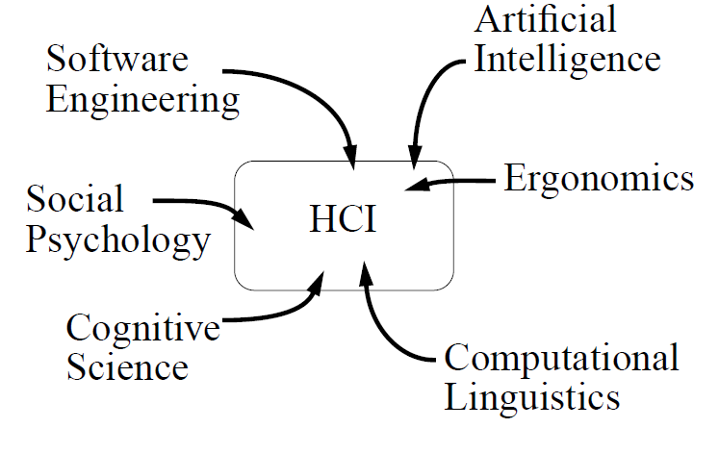
HCI is Multidisciplinary
Following figure depicts the involved fields of HCI

Slide 15
Techniques Commonly Used in HCI
Technologies such as:
  graphical user interface .
  virtual environments.
  speech recognition.
  gesture and handwriting recognition.
  multimedia presentation.
  cognitive models of human learning and understanding.
All this technologies are developed and applied as part of HCI research agendas.

Slide 16
Theory and HCI
There are three ‘use’ words that must all be true for a product to be successful; it must be:
  Useful
    To accomplish what is required (play music, cook dinner, format a document).
  Usable (Simple)
    Easily and naturally, without danger of error, etc.
  Used (Accessable)
    Make people want to use it, (attractive, engaging, fun, etc).

Slide 17
HCI in The Curriculum
HCI involves both craft and science then it must, in part at least. be taught. Imagination and skill may be qualities innate in the designer or developed through experience.
Designers cannot afford to ignore the interface in favour of the functionality of their systems, the two are too closely intertwined:
  If the interface is poor, the functionality is obscured.
  If it is well designed, it will allow the system’s functionality to support the user’s task.

Slide 18
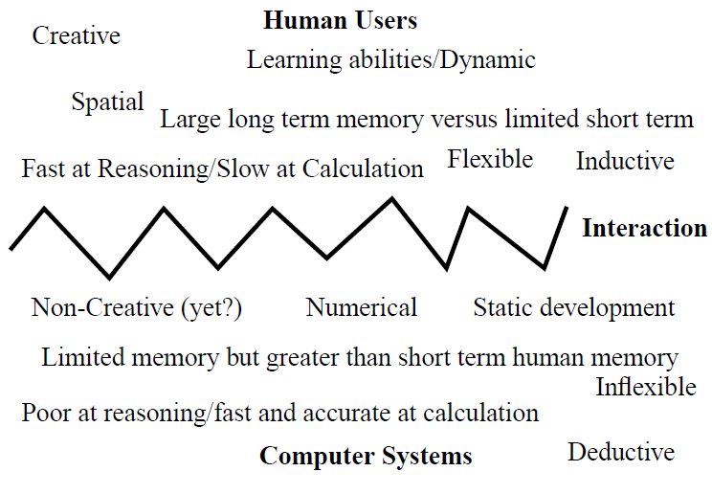
HCI Components

Slide 19
Models of Interaction
The purpose of an interactive system is to aid a user in accomplishing goals from some application domain.
Domain defines an area of expertise and knowledge in some real-world activity.
Goals is the desired output from a performed task.

Slide 20
Models of Interaction
Models of interaction are used to help us to understand exactly what is going on in the interaction and identify the likely root of difficulties.
Also provide us with a framework to compare different interaction styles and to consider interaction problems.
Norman’s model of interaction is perhaps the most influential in HCI

Slide 21
Importance of HCI
In the early days of computing only highly trained specialists could use computers.
These were massive expensive machines really only found in industry and research.
Today, computers are everywhere, and the range of knowledge and experience of different users is very broad.
The majority of computer users nowadays have not received intensive specialised training.

Slide 22
Importance of HCI
HCI is extremely important when designing clear intuitive systems which will be usable for people with a varied range of abilities and expertise, and who have not completed any formal training.
HCI takes advantage of our everyday knowledge of the world to make software and devices more understandable and usable for everyone.

Slide 23
Importance of HCI
On average, 70% of code for any real application is devoted to the Graphical User Interface.
Similar figures can be attributed to cost/effort during development.
Poor design limits the actual usage of the system.
Worst Case: the developed system might not be used at all !

Slide 24
Importance of HCI
Daily Life
  Today computers permeate every aspect of our daily lives. Even if a person does not directly own or use a computer, their life is affected in some way by computing. ATM machines, train ticket machines, and hot drinks dispensing machines.
Accessibility
  HCI is a key consideration when designing systems that are not only usable, but also accessible to people with disabilities.

Slide 25
Importance of HCI
Business and Industry
  HCI is an important consideration for any business that uses computers in their everyday operation.
  designed usable systems ensure that staff are not frustrated during their work and as a result are more productive.
  HCI is especially important in the design of safety critical systems, such as, for example, those found in
    power plants.
    air traffic control centers.
  Design errors in these situations can have serious results, possibly resulting in the death of many people.

Slide 26
Importance of HCI
  Software Success
  Good use of HCI principles and techniques is not only important for the end user, but also is a very high priority for software development companies.
  If a software product is unusable and causes frustration, no person will use the program by choice, and as a result sales will be negatively affected.

Slide 27
Importance of HCI
Untrained Users
  Very few computer users actually read the manual accompanying the software, if one exists.
  Only very specialised and advanced programs require training and an extensive manual.
  Computer users expect to understand the main functionality of an average program within a few minutes of interacting with it.
  HCI provides designers with the principles, techniques, and tools necessary to design effective interfaces that are obvious and easy to use, and do not require training.

Slide 28



